Slide 1
11.7 Testing data

Slide 2
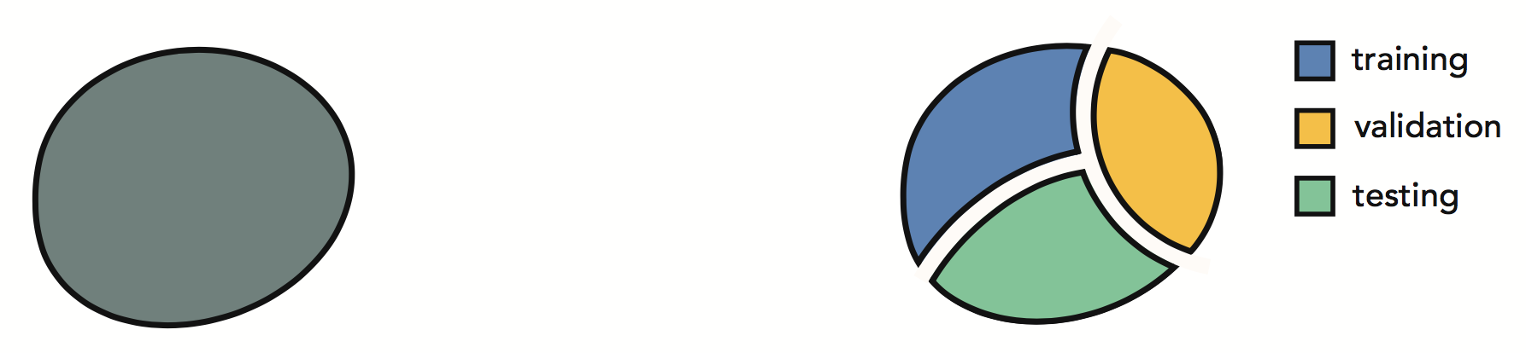
As with training data, it is also possible to overfit to validation data as well during the cross-validation procedure.
Provided the dataset is large enough, we can ameliorate this risk by splitting our original data into not two sets (training and validation), but three: raining, validation, and testing sets.

Slide 3
After the cross-validated model is constructed its quality is measured on the testing data, on which it has neither been trained nor validated on.
This testing error gives an unbiased estimate of the cross-validated model's performance, and is generally closer to capturing the true error of our model on 'future data generated by the same phenomenon'.

Slide 4
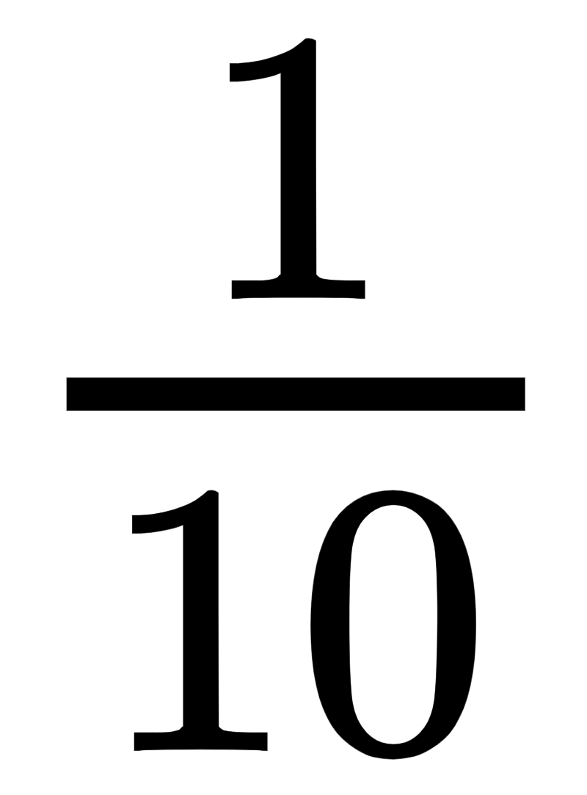
What portion of the original dataset should we assign to our testing set?
As with the portioning of training and validation, there is no general rule for portioning.
Note: the use of testing data is a luxury we can indulge in only when we have a large amount of data. When data is scarce we must leverage it all just to build a halfway reasonable cross-validated model.
When data is plentiful, often the size of validation and testing sets are chosen similarly, e.g., if of a dataset is used for validation, often for simplicity the same portion is used for testing as well.

